Slide 1
MGMT590 - Visual Analytics
Session 5
Dr. Cecilia Ying
Updated: 09/14/2025

Slide 2
Today’s Agenda
Session 4
Special graphs “show and tell”
Storytelling with Data
Crafting a Compelling Story
Articulating the Story – Preview
Assignment 1 working session (due tonight, 11:59 pm)

Slide 3

Special Graph “Show and tell”

Slide 4
Module 4: Storytelling with Data
Overview

Slide 5
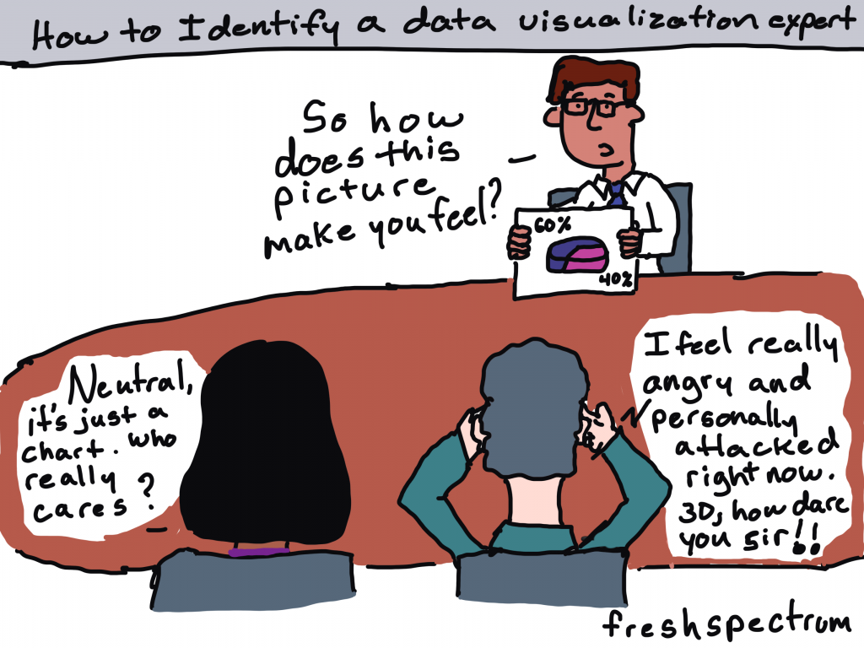

Slide 6
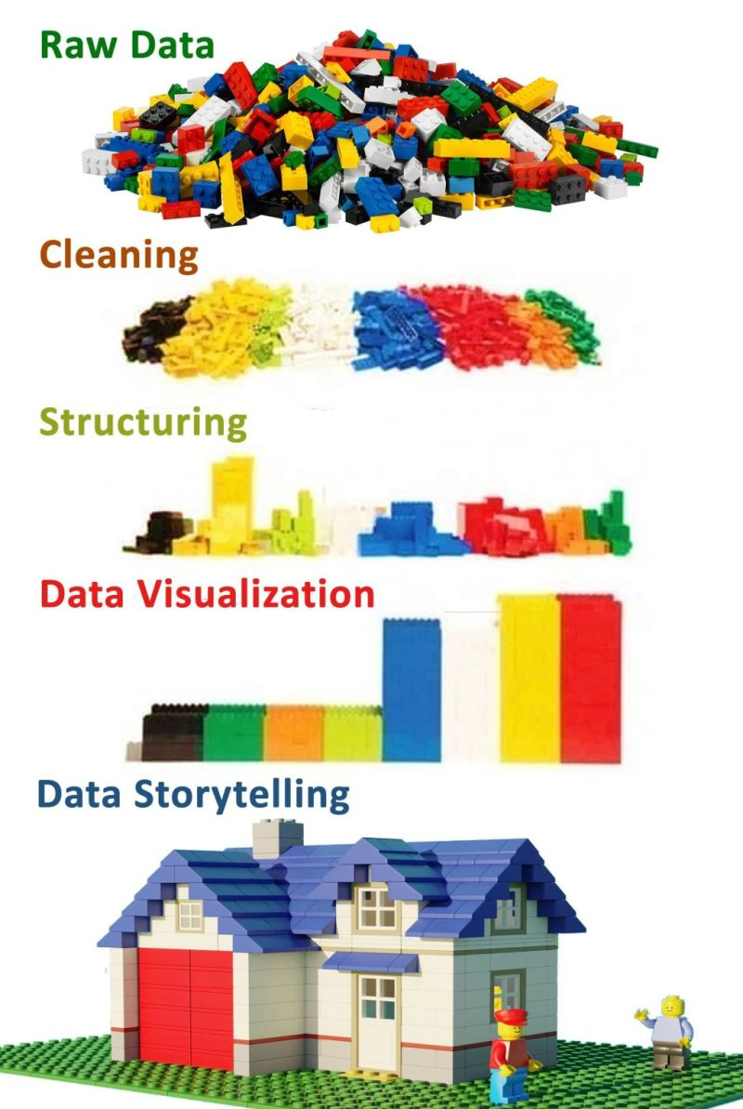
Storytelling with data
It’s just like building a house
Crafting the story
The architecture and blueprint
Creating a functional structure that meets the audience's needs.
Articulating the story
The construction and interior design
Using the right materials (visuals), a tidy look (decluttering), and clear signs (language) will make the house comfortable and easy to navigate.

Slide 7
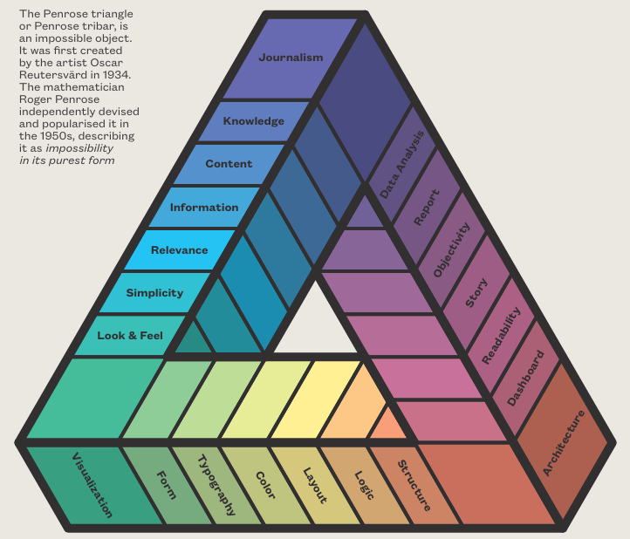

The Penrose triangle
Idea, Design and Data
Crafting the Story
Articulating the Story
Notes:
Rendgen, S., & Wiedemann, J. (2019). History of information graphics.

Slide 8
Storytelling with Data
Part 1 – Crafting a Compelling Story

Slide 9
WHAT is the story you are trying to tell?
Finding the narrative hidden within the data
1. Audience & Context (The Foundation)
2. The “Big Idea” (The Core Message)
3. The Narrative Arc (The Structure)
4. Conflict & Stakes (The Hook)

Slide 10
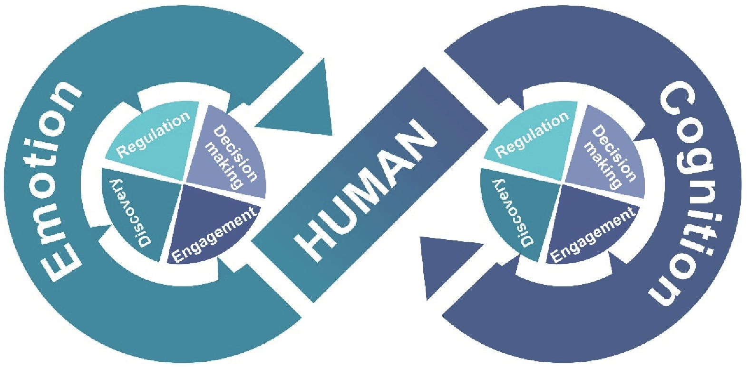
WHAT is the story you are trying to tell?
Finding the narrative hidden within the data
1. Audience & Context – The Foundation
There is an interconnected relationship between human emotion and human cognition, which drives decision-making.
Know your audience: Connect! Make them care!
Who are you talking to? What do they care about?
What is their level of expertise?
What decisions do they need to make? Or what decisions can they make?
What is the background context to help them connect -> to care
Zhao, G., Li, Y., & Xu, Q. (2022). From emotion AI to cognitive AI.
International Journal of Network Dynamics and Intelligence, 65-72.

Slide 11

Technology Managers vs. HR Managers
How will your story change
Speak their language
Who are you talking to? What do they care about?
What is their level of expertise?
What decisions do they need to make? Or what decisions can they make?
What is the background context to help them connect -> to care

Slide 12
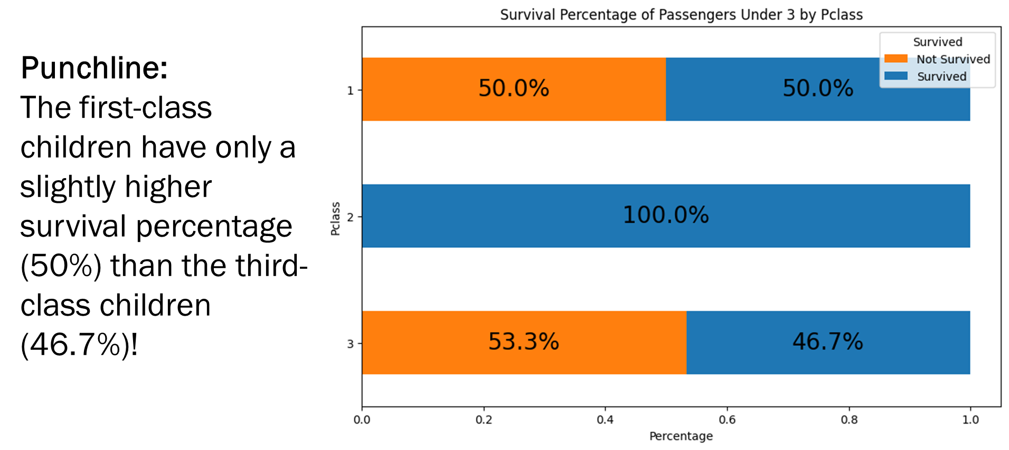
WHAT is the story you are trying to tell?
Finding the narrative hidden within the data
2. The “Big Idea” – The Core Message
This is the big “headline” of your story
Don’t just show the data, make a point!
Every piece of data, every chart, every talking point you include must directly support this one central message

Slide 13
WHAT is the story you are trying to tell?
Finding the narrative hidden within the data
3. The Narrative Arc – The Structure
The Hook
The Conflict
The Resolution
Every story needs a beginning, middle, and an end.
A good story focuses on a central conflict
Deliver your key finding or “Big Idea”:
Clear conclusion, a recommendation, or a call to action.
Present the supporting data and evidence:
The “Aha!” moments
Exploratory path that led you to your conclusion
Start with the context:
Present a problem, a question, or a surprising insight to grab the audience’s attention

Slide 14
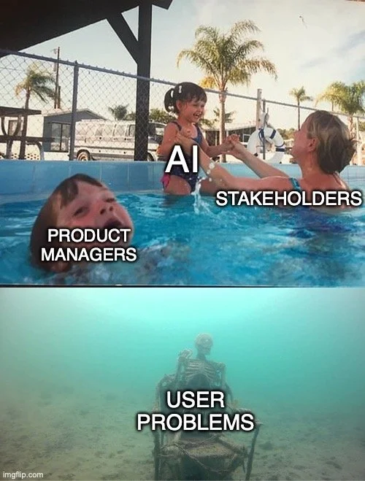
WHAT is the story you are trying to tell?
Finding the narrative hidden within the data
4. Conflict and Stakes – The Hook
“A story without conflict is just a report.”
The gap between “what is” and “what could be”
The problem you’re trying to solve
The opportunity you identified
Tension between two competing metrics

Slide 15
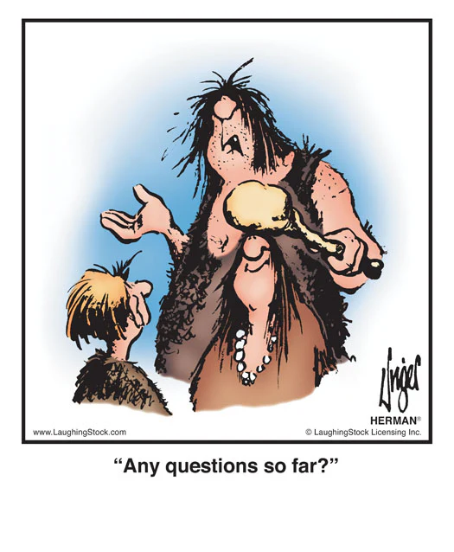
Questions?

Slide 16


Yes, coach – I got this
How I think I look
How I think I look
How I (actually) look

Slide 17
In class exercise
Let’s go through this together
1. Audience & Context (The Foundation)
2. The “Big Idea” (The Core Message)
3. The Narrative Arc (The Structure)
4. Conflict & Stakes (The Hook)
Let’s use the Titanic dataset as an example

Slide 18
WHAT is the story you are trying to tell?
Finding the narrative hidden within the data
1. Audience & Context – The Foundation
There is an interconnected relationship between human emotion and human cognition, which drives decision-making.
Know your audience: Connect! Make them care!
Who are you talking to? What do they care about?
What is their level of expertise?
What decisions do they need to make? Or what decisions can they make?
What is the background context to help them connect -> to care
Zhao, G., Li, Y., & Xu, Q. (2022). From emotion AI to cognitive AI.
International Journal of Network Dynamics and Intelligence, 65-72.

Slide 19
WHAT is the story you are trying to tell?
Finding the narrative hidden within the data
2. The “Big Idea” – The Core Message
This is the big “headline” of your story
Don’t just show the data, make a point!
Every piece of data, every chart, every talking point you include must directly support this one central message

Slide 20
WHAT is the story you are trying to tell?
Finding the narrative hidden within the data
3. The Narrative Arc – The Structure
The Hook
The Conflict
The Resolution
Every story needs a beginning, middle, and an end.
A good story focuses on a central conflict
Deliver your key finding or “Big Idea”:
Clear conclusion, a recommendation, or a call to action.
Present the supporting data and evidence:
The “Aha!” moments
Exploratory path that led you to your conclusion
Start with the context:
Present a problem, a question, or a surprising insight to grab the audience’s attention

Slide 21
WHAT is the story you are trying to tell?
Finding the narrative hidden within the data
4. Conflict and Stakes – The Hook
“A story without conflict is just a report.”
The gap between “what is” and “what could be”
The problem you’re trying to solve
The opportunity you identified
Tension between two competing metrics

Slide 22
Preview: Storytelling with Data
Part 2 – Articulating that Compelling Story

Slide 23
Articulating the Story: The “HOW”
Clear, memorable, and persuasive
1. Choosing the Right Visuals (The Vehicle)
2. Focusing Attention (The Spotlight)
3. Clear and Concise (The Script)
4. The Narrative Flow (The Guideposts)

Slide 24
Assignment 1
Working Session

Slide 25

That’s a wrap

Slide 26
Course Schedule
At a glance

Slide 27
Assignment 1
Titanic – who will survive?

Slide 28
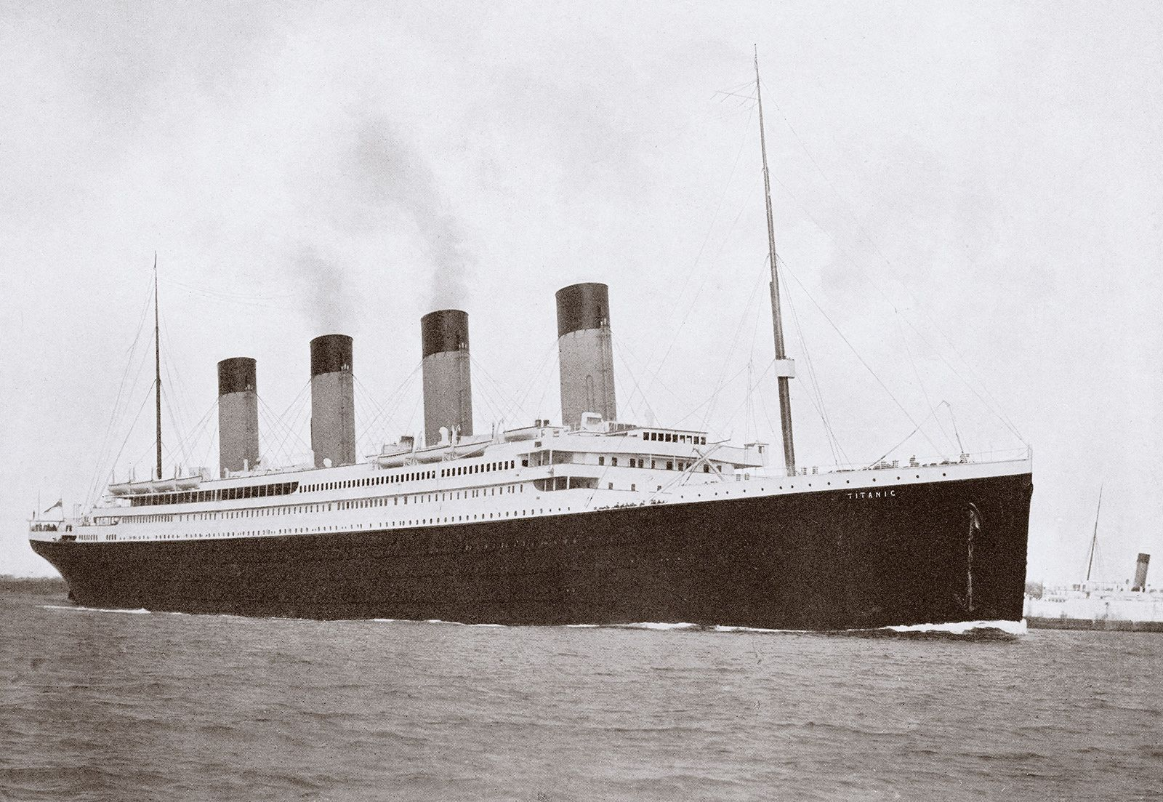
Titanic
Finding insights from the data
Data Understanding & Preparation
Assess the quality of the data
Create a plan to address (through data engineering)
Potentially incorrect data
Missing data
Collection of additional data that might be useful
Decision-making
Given the data you have and the understanding of who is more likely to survive, what else could be done to improve the survival rate?
Obviously, other than “adding more lifeboats”

Slide 29
Team Project
Building your “killer figure”

Slide 30
Team Project Description
Building your “killer figure”
Context
You are pitching a business case to a group of senior technology executives at your company, but a call came in, and the CTO will have to leave the meeting in 5 minutes.

Slide 31
Team Project Description
Building your “killer figure”
Challenge
You have 5 minutes to summarize your key findings, assumptions, and/or projections to convince your CTO that YOUR project is worth funding.

Slide 32

Ryan Buell’s famous “Killer Figure”
Professor from Harvard Business School https://www.hbs.edu/faculty/Pages/profile.aspx?facId=320524
“You should be able to summarize your entire presentation using ONE KILLER FIGURE.”

Slide 33
Team Project Description
Building your “killer figure”
Your Tasks
Identify a domain that is interesting to your team.
Find a dataset in that domain (common places to look: HuggingFace, Kaggle, UCI, Papers with Code)
Craft a project idea based on the data you are using (more on the next slide)
Create one killer figure that clearly tells your story
5-minute in-class presentation using the killer figure

Slide 34
Team Project Description
Building your “killer figure”
Project Objectives
Crafting a compelling story with data
Clearly articulate that story with one killer figure
Be creative and have fun

Slide 35
Team Project Description
Building your “killer figure”
Crafting Your Idea
What problems are you trying to solve?
What questions are you trying to answer?
What kind of data will you need?

Slide 36
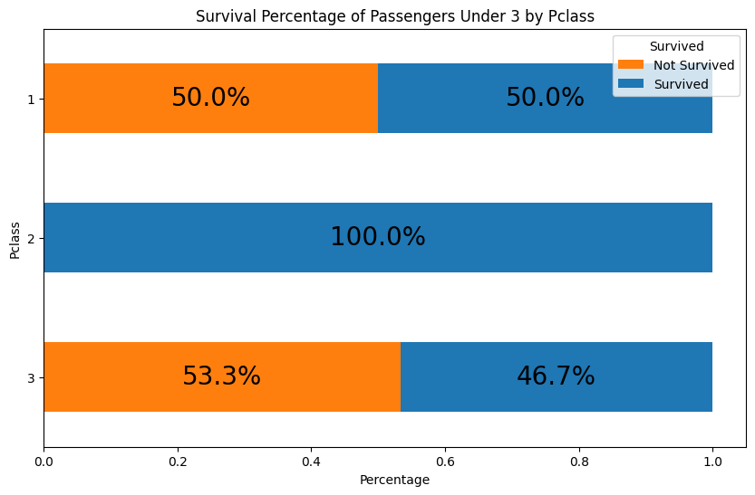
Team Project Description
Building your “killer figure”
Punchline:
The first-class children have only a slightly higher survival percentage (50%) than the third-class children (46.7%)!

Slide 37
Team Project Description
Building your “killer figure”
The first-class children pay, on average $151, which is 6 times higher than third-class children, who pay, on average $23. And yet, the company failed to ensure their safety.
Business proposal to
Improve the overall survival percentage for all children.

Slide 38
Team Project Description
Building your “killer figure”
Watch this video for inspiration (as needed)
How Consulting Firms Make Complex Topics Simple
Analyst Academy

Slide 39
Common Data Sources
Some recommendations
Huggingface: https://huggingface.co/docs/datasets/en/index
Kaggle: https://www.kaggle.com/datasets (Here you will also easily find code/notebooks from others, but be careful when using someone else's code - it might take more time to debug than write your own)
UCI: https://archive.ics.uci.edu/datasets
Papers with code: https://paperswithcode.com/datasets (this one is great if you want to read the research that's been done on the particular dataset)

Slide 40
How to use Power BI, Tableau, Excel/ VBA, Python, R…
Course objectives & preferred tools
Course objectives: Who, What, When, Where…
Exercising your managerial muscles
Focus on the story behind the data
You are free to use whatever graphical tools you are most familiar with (this course is not about the HOW)
Special Workshops during TA office hours on Tuesdays.

Slide 41

Questions?

